Slide 1

INTERNSHIP REPORT FOR WEEK 4
MITRE ENGAGE
Honeypots
-ARUN ASHOK BADRI

Slide 2
MITRE ENGAGE AND IMPLEMENTATION OF AFFECT GOAL USING HONEYPOTS
INTERNSHIP REPORT PLAN
Month 1: Orientation and Goal Selection
Month 2: Proposal and Planning
Month 3: Implementation and Documentation

Slide 3
Honeypot
Honeypots refer to decoy servers or systems that are deployed next to systems your organization actually uses for production.
Honeypots are designed to look like attractive targets, and they get deployed to allow IT teams to monitor the system’s security responses and to redirect the attacker away from their intended target.
Honeypots use security vulnerabilities to lure in attackers. They may have ports that are vulnerable to a port scan, which is a technique for figuring out which ports are open on a network. A port left open may entice an attacker, allowing the security team to observe how they approach their attack.

Slide 4
How Do Honeypots Work?
A honeypot can, for instance, pretend to be a system that contains sensitive consumer data, such as credit card or personal identification information.
The purpose of a honeypot is to refine an organization’s intrusion detection system (IDS) and threat response so it is in a better position to manage and prevent attacks.
There are two primary kinds of honeypots: production and research
Production honeypots focus on the identification of compromises
Research honeypots, collect information regarding attacks

Slide 5
The Complexities of Honeypots
There are different types of honeypots, designed for different production or research purposes.
1. Pure Honeypot -- It completely mimics the production system, very resource intensive.
2. High-interaction Honeypot -- designed to get attackers to invest as much time as possible inside the honeypot. A high-interaction honeypot may have extra systems, databases, and processes that the attacker will want to try to infiltrate.
3. Mid-interaction Honeypot -- Mid-interaction honeypots imitate elements of the application layer, but they do not have an operating system.
4. Low-interaction Honeypot -- Low-interaction honeypots are less resource-intensive. there is nothing inside the honeypot to hold the attacker’s attention for a considerable amount of time.

Slide 6
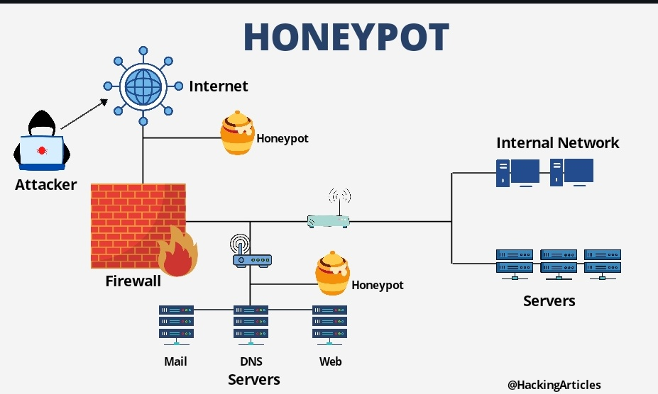

Slide 7
Uses of Honeypot Implementation
Honeypot security involves connecting a fake asset to the internet & make it vulnerable to attacks
1. Database Attack Scenario -- An ecommerce company can set up a fake SQL server that appears to contain a database of the Credit Cards used by the customers across their website
2. Insider Attack -- They may establish a fake server that has the same stringent access controls as the one they suspect the insider attacker may be after.
3. Random Attacks -- they may make the asset relatively easy to hack into, just so they can get more data to use in their intel.

Slide 8

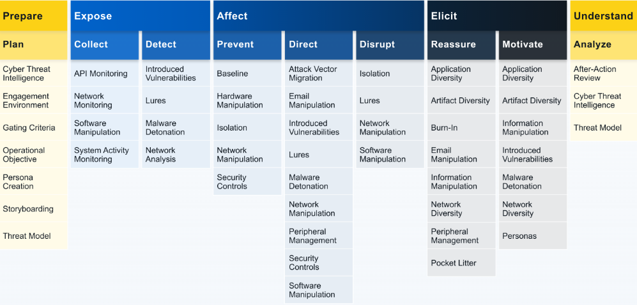
ENGAGE MATRIX

Slide 9
LET‘S DISCUSS ABOUT -
HONEYPOTS & AFFECT (Mitre ENGAGE)
Affect is ultimately about changing the cost-value proposition in cyber operations for the adversary.
Using the Honeypot we can “Negatively Affect” the Adversaries

Slide 10
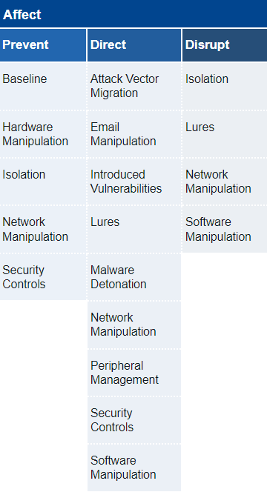


HONEYPOTS CAN BE USED TO ACHIEVE -
. ISOLATION : Honeypots can ensure that certain networks are isolated
. LURES : Using Honeypots we can introduce Lures and Decoys against the Adversaries
. NETWORK MANIPULATION : We can manipulate the network by installing Honeypots and trick the adversaries

Slide 11
NETWORK MANIPULATION
Here's how honeypots can be used for network manipulation within the context of MITRE Engage:
Logging and Monitoring
Emulating Vulnerabilities
Alerting and Notification
Network Isolation

Slide 12
TECHNIQUES USED IN HONEYPOTS:
Deception Techniques:
Port and Service Deception: Simulating open ports and services to attract attackers.
Data Deception: Providing fake data or files that seem valuable to attackers.
Credential Deception: Presenting fake login screens to capture attacker credentials.
Protocol Deception: Simulating network protocols and behaviors that may not exist in the real environment.

Slide 13
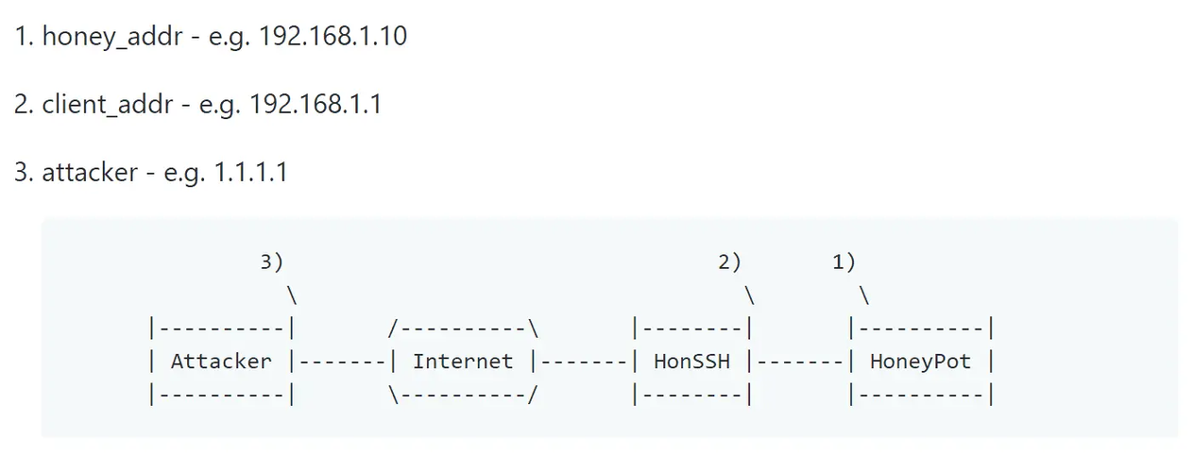
HonSSH
HonSSH is designed to be used in conjunction with a high interaction honeypot. HonSSH sits between the attacker and the honey pot and creates two separate SSH conncetions.
It will sit between an attacker and a honeypot, creating two separate SSH connections between them.

Slide 14
FEATURES OF HonSSH
Captures all connection attempts to a text file, database or email alerts.
When an attacker sends a password guess, HonSSH can automatically replace their attempt with the correct password (spoof_login option). This allows them to login with any password but confuses them when they try to sudo with the same password.
A text based summary of an attackers session is captured in a text file.
Sessions can be viewed or hijacked in real time (again thanks to Kippo) using the management telnet interface.
Downloads a copy of all files transferred through wget or scp.
Can use docker to spin up new honeypots and reuse them on ip basis.
Advanced networking feature to spoof attackers IP addresses between HonSSH and the honeypot.

Slide 15
NETWORK MANIPULATION / DECEPTION
Trying to create a network environment in which we can implement an honeypot and try to determine the AFFECT it has on the adversarial attacks.
Tools needed are:
Proxmox VE
HonSSH
Kali Linux
And their individual requirements

Slide 16
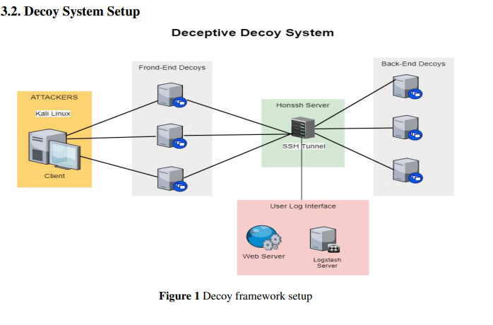
NETWORK MANIPULATION/ DECEPTION
VM2
VM1
VM3
PROXMOX VIRTUAL ENVIRONMENT

Slide 17
Network manipulation Setup
VM1 -- ATTACKER
VM2 -- GATEWAY
VM3 -- ANALYSIS & LOGGING
OS: Kali Linux
Same network
Attacks using Nmap and other tools
Eg: Os fingerprinting,
Directory Search
OS: Ubuntu Server
Same network
Uses HonSSH to tunnel between decoy and the honeypot
OS: Ubuntu Server 18.0
Same network
Elasticsearch, Kibana, Logstash
The integration of these 3 tools is used for log analysis

Slide 18
Network manipulation Setup (Additional)
VM2 -- GATEWAY
OS: Ubuntu Server
Same network
Uses HonSSH to tunnel between decoy and the honeypot
CT1 -- FRONTEND DECOY
CT2 -- BACKEND DECOY
OS: Ubuntu LCX
MySQL, Apache Etc
Same network
Serves as a decoy back end and also tunnels data via SSH
OS: Ubuntu LCX
Same network
Serves as a fake frontend and it is tunneled via SSH

Slide 19



Slide 20
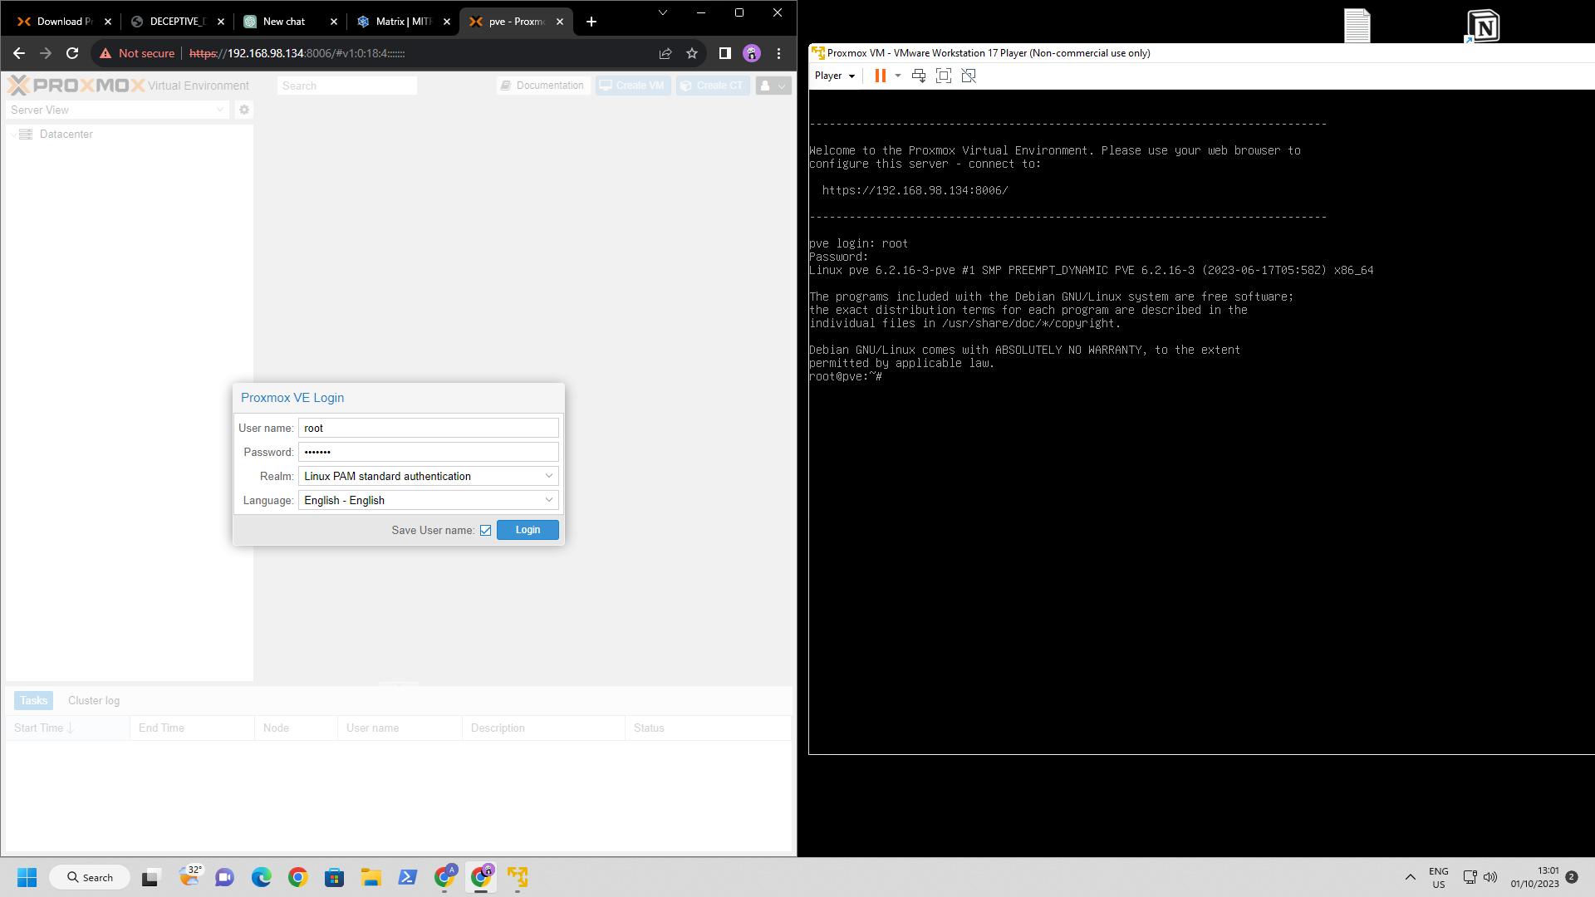

Slide 21
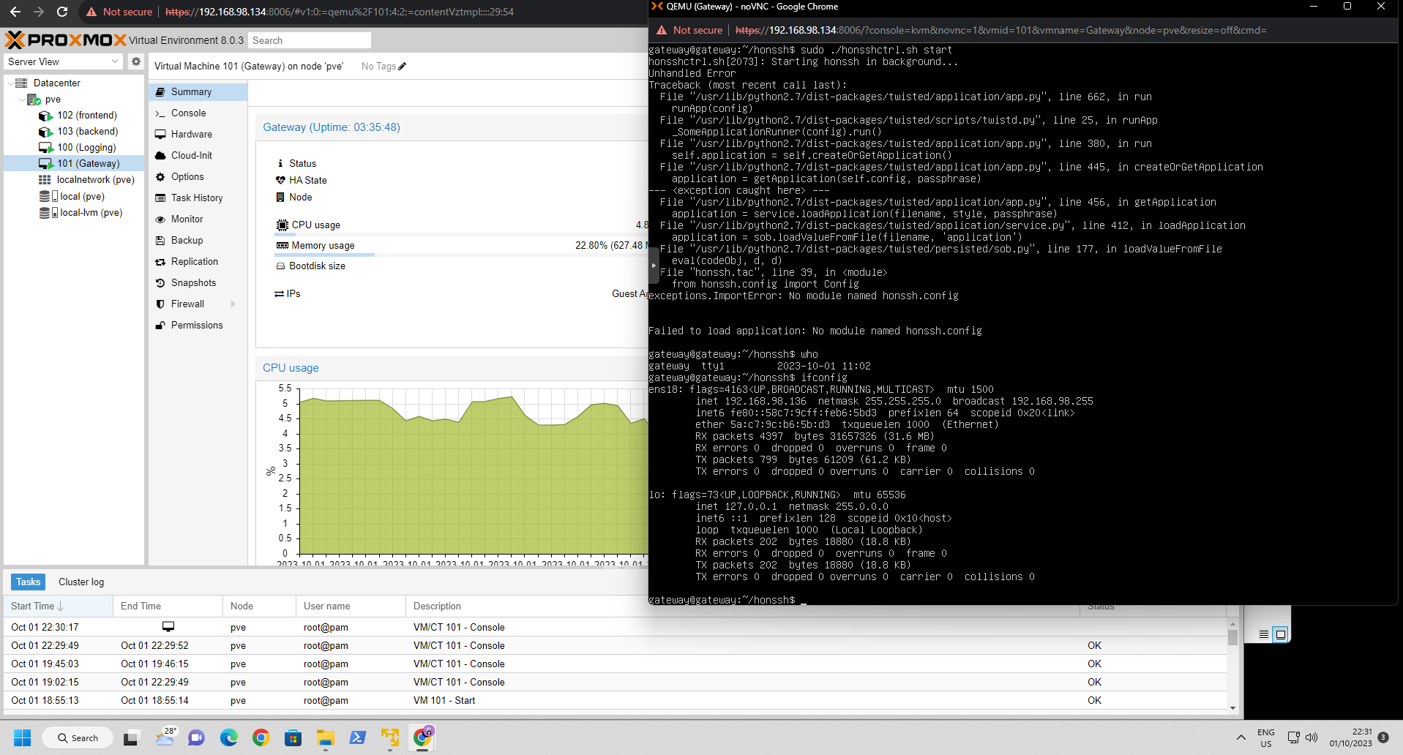

Slide 22
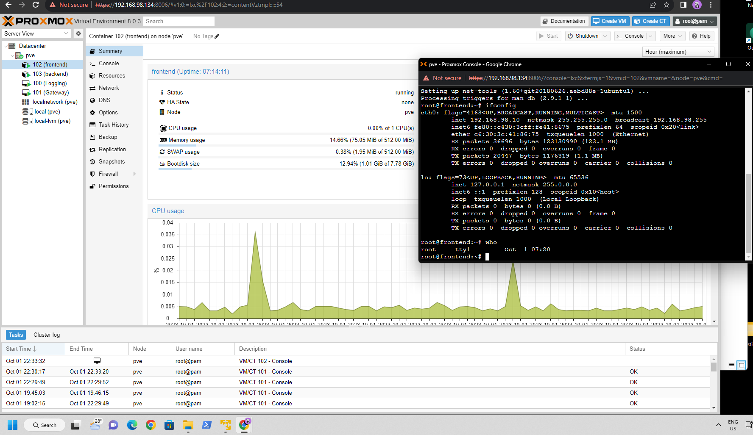

Slide 23
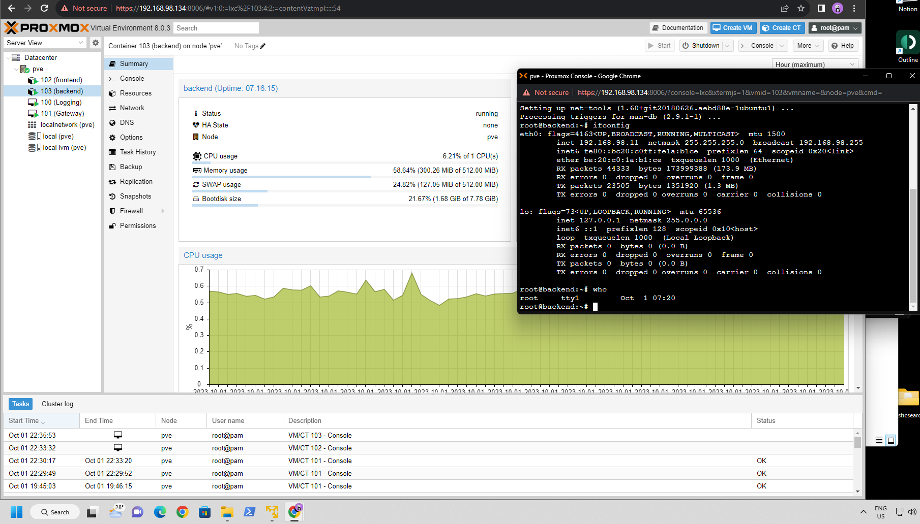

Slide 24
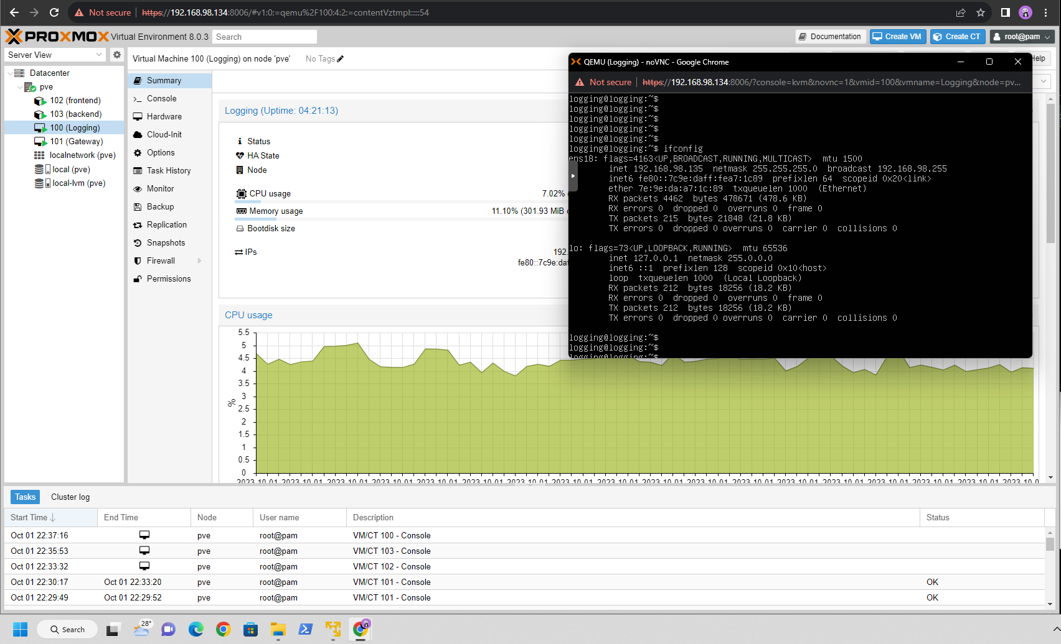

Slide 25

HonSSH installation
Git Clone into the following Repo
https://github.com/tnich/honsh
cd into the Directory:
Edit the “honssh.cfg.default” file in the direcory with suitable values

Slide 26
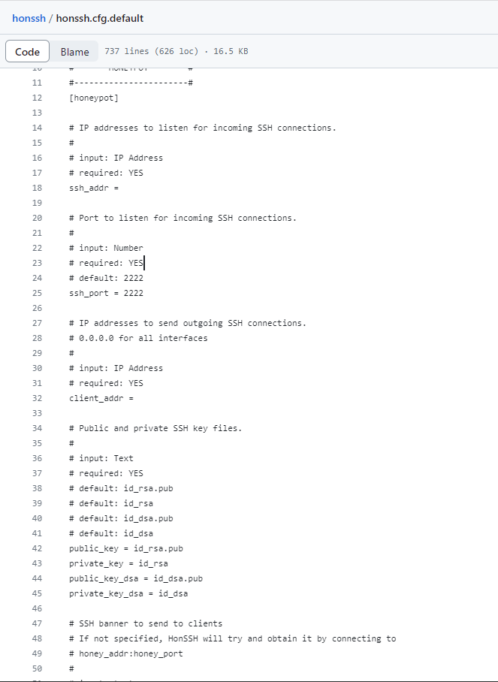



SSH Incoming Address // usually 0.0.0.0 for every address
Destination of the Data packets to be sent i.e Analysis and Logging VM
Keygens are generated during the execution

Slide 27
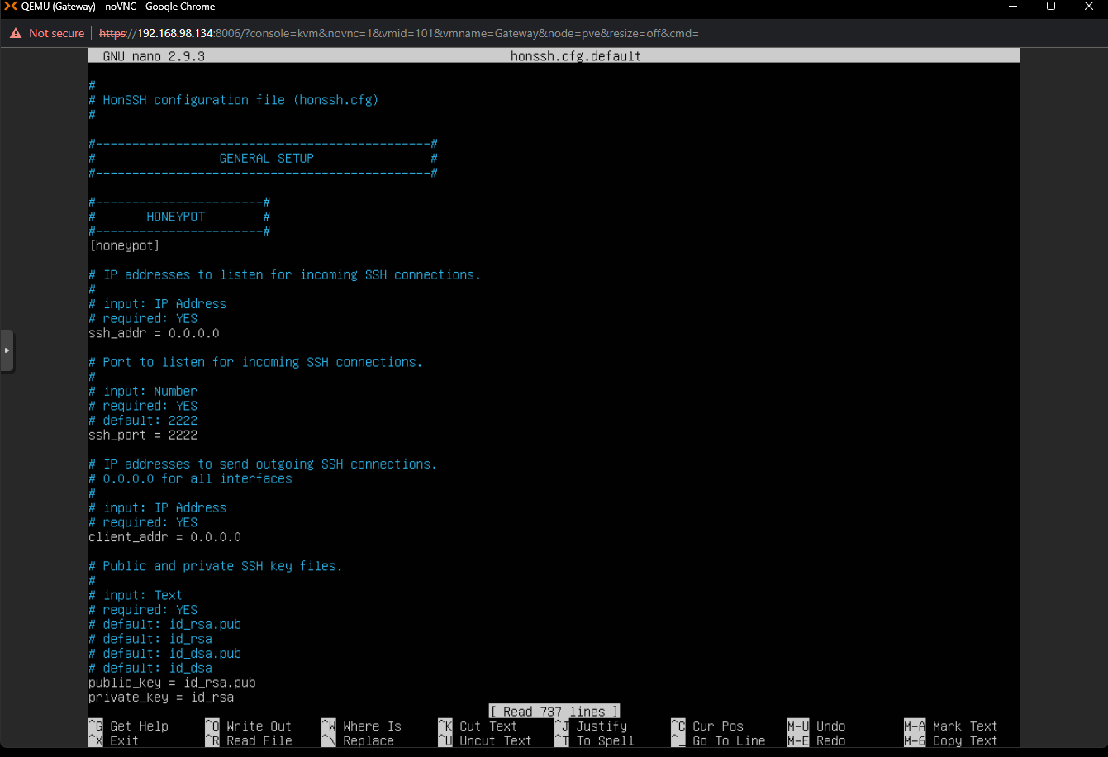

Ensures all the address are being listened to
Needs to be configured yet

Slide 28
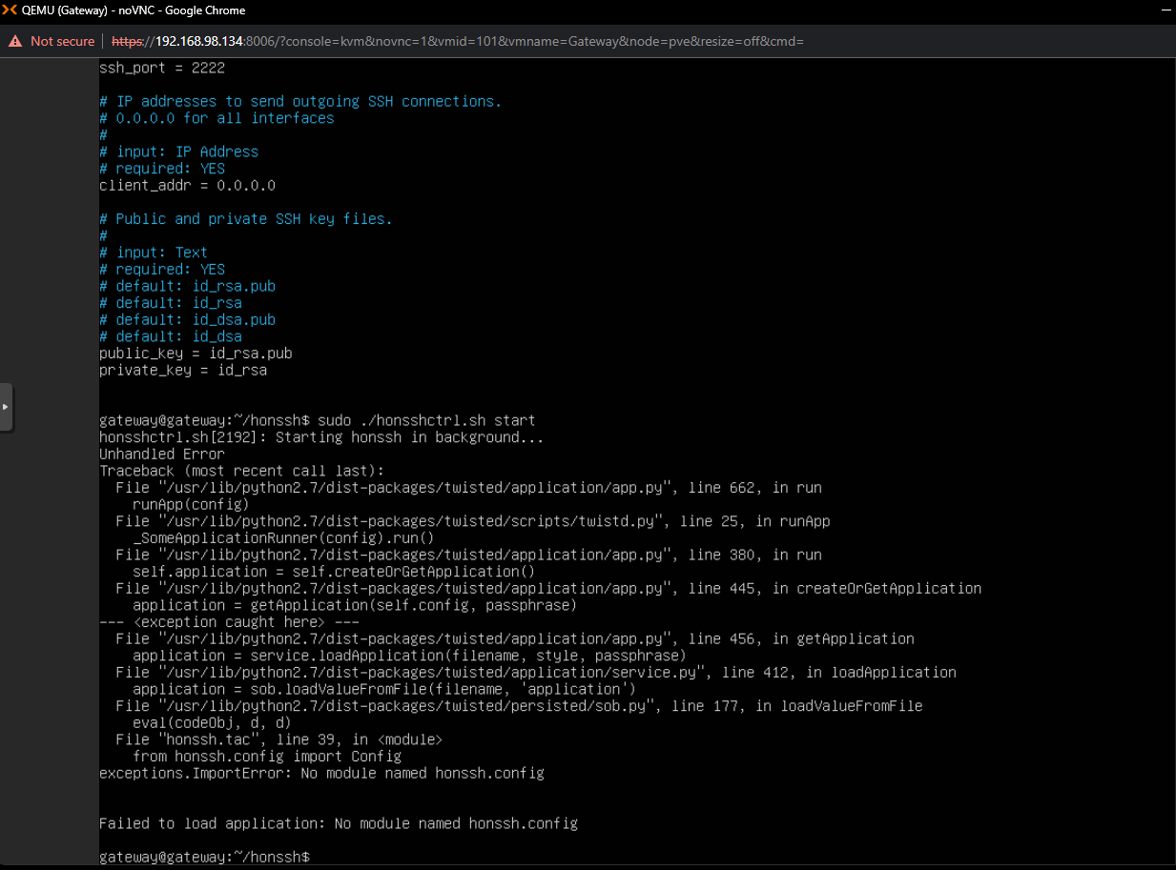
Once everything is ready we can run the HonSSH using this command
Error during the installation
--Needs to be Rectified

Slide 29
Next Steps in the Implementation
-> Rectify the Error in HonSSH
-> Setup ELK (Elasticsearch, Logstash, Kibana) in the VM3
-> Setup SSH tunneling in the Frontend and Backend Decoys
-> Configure VM1 Kali Linux
-> Setup fake virtual IP’s in the Network via HonSSH
-> Setup Password logging feature of the HonSSH
-> Integrate and test the final Environment using real world attack

Slide 30

Reference material
https://iaeme.com/MasterAdmin/Journal_uploads/IJEET/VOLUME_12_ISSUE_6/IJEET_12_06_027.pdf
Research paper on “combination of deceptive network and Honeypots to increase effective security”

Slide 31
Thank
you!

